Slide 1
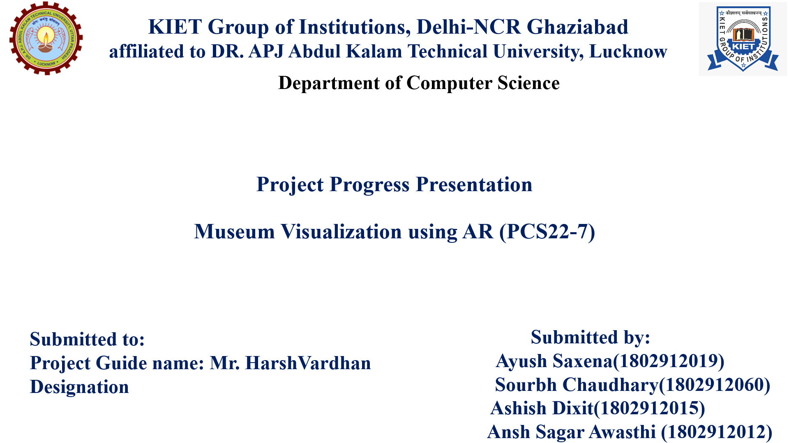

Slide 2
Introduction
Recently, advances in computer graphics and interactive techniques have expended the visual quality and field of Augmented Reality (AR) applications.
This projects develops an Android application for museum visualisation using Google AR Core.
It is a portal that open entrance to new and exciting virtual museum.
Process -
Scan the floor
Instantiate the portal
Walk through the portal and explore museum

Slide 3
Problem statement
Museum usually holds a lot of collection of artifacts which they cannot exhibit them publicly especially those unique artifacts.
One of the disadvantages of the conventional exhibition is the interaction between the visitors and the artifacts are limited.
Information size is restricted by the physical area of the panel or paper
Museums might not have enough space and resources for them to exhibit the whole collection of artifacts to the public

Slide 4
Objective
The objectives of this project are:
To design and develop an effective system for user and artifacts interaction using Augmented Reality technology .
To enhances the effectiveness of artifact exhibition

Slide 5
Project scope
The scope of this project is to digitize the museum artifacts as real as original artifacts and display it in real scene using AR core .
This system can help to enhance the visitor’s enthusiasm of learning and research about the cultural heritage.

Slide 6
Literature
AR is a computer generated system that allows user to immerse in interactive 3D environment. This technology has been use to reconstruct the archaeological artifacts and historical sites.This project developed by using 3D multimedia tools to record, reconstruct, encode and visualized archeological ruins in Augmented Reality. It is aimed at developing a system capable of recording archaeology excavation phases using Virtual Reality techniques.

Slide 7
Technology Used
VuForia Development kit SDK
Google AR Core
Unity 3D Game Engine
Google Poly 3D

Slide 8
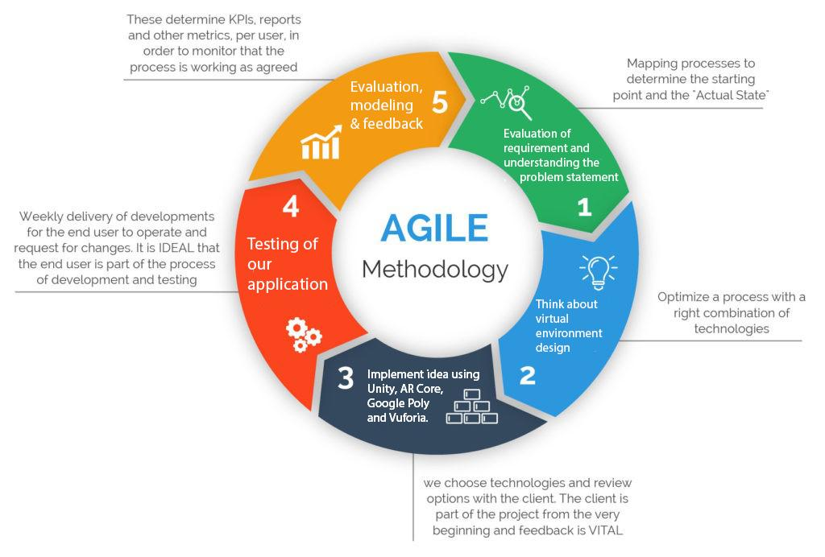
SDLC Model

Slide 9
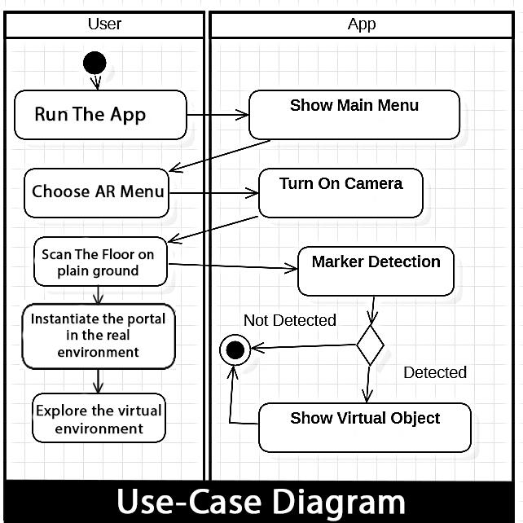
Use Case Diagram

Slide 10
Thank You

